Slide 1
Table of contents
Week 7
Name of the lesson: What type of worker are you?
Lesson objectives
Characterize different types of workers.
Adjectives to describe people and personality traits.
Descriptions in the first- and third-person singular and plural.
Positive and negative traits: discussion.

Slide 2
This lesson will be
recorded
Notes:
Remember that all lessons are recorded.

Slide 3
Week 7 – LEVEL 1
What type of worker are you?

Slide 4


Weekly plan
Part I
Part II
What type of worker are you?
Oral focus
Describe workers
Personality traits
Reading comprehension
Group discussion
Describe your working style using the vocabulary learned this week.
Notes:
Each weekly plan includes 2 classes. The second class is always practice-based, with a focus on oral or written work.

Slide 5
Getting started

Slide 6

Let’s think together
Estimated time: 10 minutes
Notes:
Usar para Actividades en clase.

Slide 7


Describe the workers in the picture
Answer using the chat
Estimated time: 5 minutes
Notes:
T asks Ss to describe what they see. Depending on the group level, the discussion can be carried out in Spanish or English. Some questions that T can ask: Where do they work? What do they look like? Who do you identify with? Why?

Slide 8


Who of the worker is… ?
Responsible
Creative
Hard-working
Decisive
Answer using the chat
Estimated time: 5 minutes
Notes:
Ss answer 1 or 2 via chat

Slide 9
Group discussion
Let’s analyze personality traits and decide if they are qualities or flaws workers may have
Estimated time: 20 minutes

Slide 10

GROUP DISCUSSION
María
This is María. She is a content creator at a big company. She is very creative and productive, but sometimes she is delayed in traffic and arrives late to work, so she’s not always punctual.
What are the positive and negative traits?
Answer using the chat

Slide 11
GROUP DISCUSSION
María
This is María. She is a content creator at a big company. She is very creative and productive, but sometimes she is delayed in traffic and arrives late to work, so she’s not always punctual.
What are the positive and negative traits?
Answer using the chat
Notes:
Give ss some moments to think about the answers. Clarify meaning if necessary.

Slide 12

GROUP DISCUSSION
Paolo
This is Paolo. He works in finance. He can be bossy sometimes, especially when there is a problem. But he is loyal to his team, he always listens to them, and he is an example for his colleagues, a hardworking person.
What are the positive and negative traits?
Answer using the chat
Notes:
Give ss some moments to think about the answers. Clarify meaning if necessary.

Slide 13
GROUP DISCUSSION
Paolo
This is Paolo. He works in finance. He can be bossy sometimes, especially when there is a problem. But he is loyal to his team, he always listens to them, and he is an example for his colleagues, a hardworking person.
What are the positive and negative traits?
Answer using the chat
Notes:
Give ss some moments to think about the answers. Clarify meaning if necessary.

Slide 14

GROUP DISCUSSION
Kim and Lucas
They are Kim and Lucas. They are not very experienced, but they are young, proactive and team players. Their lead likes that they are cooperative and that they adapt easily, they are very flexible.
What are the positive and negative traits?
Answer using the chat
Notes:
Give ss some moments to think about the answers. Clarify meaning if necessary.

Slide 15
GROUP DISCUSSION
Kim and Lucas
They are Kim and Lucas. They are not very experienced, but they are young, proactive and team players. Their lead likes that they are cooperative and that they adapt easily, they are very flexible.
What are the positive and negative traits?
Answer using the chat
Notes:
Give ss some moments to think about the answers. Clarify meaning if necessary.

Slide 16
Reading comprehension
Let’s read the opinion a lead has of some workers and answer some comprehension questions.
Estimated time: 15 minutes

Slide 17

READING COMPREHENSION
Rita: a lead with experience
As a team lead at an IT company with 15 years of experience in the role, I have the opportunity to work with young interns and workers. While there are many talented and capable individuals among them, I see a recurring challenge: young people are not detail-oriented and responsible enough, they always have an excuse! After some years, now I’m less tolerant with these situations, so in many occasions my interns think that I’m too strict or even rude, but I just want them to learn how to be the best workers!
Notes:
Depending on the group, T or Ss read aloud the description and guess using the chat.
Windows
Amazon
Meta
Google
Apple

Slide 18
READING COMPREHENSION
Rita: a lead with experience
Answer the following questions:
What qualities does Rita value in workers?
What qualities does she see in interns and young people?
What negative traits or flaws does she see as a challenge?
What do her interns think of her?
Follow up: What do you think of Rita’s ideas?
Estimated time: 15 minutes
Notes:
T gives ss some time to go back to the text and find the information. Then, they go over the questions one by one, and answer using the chat. Alternatively, Ss can answer orally. From the information provided by Ss, build complete sentences and write them back in the chat to integrate the contents of this class with the use of present simple for 3rd person singular. Follow up question is discussed orally in English or Spanish depending on the group abilities.

Slide 19

Break-time
We’ll be back in 10 minutes!

Slide 20
Language focus
Let’s go deeper into personality traits and type of workers with different exercises
Estimated time: 20 minutes

Slide 21
LANGUAGE FOCUS
Personality traits: opposites
Find the opposite adjective and match
strict
lazy
hardworking
rude
polite
slow
productive
lenient
Estimated time: 5 minutes

Slide 22
LANGUAGE FOCUS
Personality traits: opposites (key)
Find the opposite adjective and match
strict
lazy
hardworking
rude
polite
slow
productive
lenient

Slide 23
LANGUAGE FOCUS
Personality traits: opposites
Find the opposite adjective and match
extrovert
unpunctual
detail-oriented
impulsive
punctual
introvert
Analytical
careless
Estimated time: 5 minutes

Slide 24
LANGUAGE FOCUS
Personality traits: opposites
Find the opposite adjective and match
extrovert
unpunctual
detail-oriented
impulsive
punctual
introvert
Analytical
careless

Slide 25
Breakout rooms activity
Let’s match some people’s descriptions of their work styles to work-related personality traits
Estimated time: 20 minutes

Slide 26
Breakout rooms activity
Workers and personality traits
You will read descriptions of some workers’ personalities. Decide which traits describe them best and report your discussion to the whole class
Estimated time: 20 minutes
Notes:
ACTIVIDAD que se puede llevar a cabo en formato “Breakout Rooms”
Para el profesor:
Crear breakout rooms para los equipos. De no saber cómo, favor de revisar el siguiente tutorial:
En PPT: https://docs.google.com/presentation/d/1vieCGzAPuYf5vWsu8Xgbn_2Ax4QNLnXO/edit?usp=sharing&ouid=103396586770751045195&rtpof=true&sd=true
En video: https://www.youtube.com/watch?v=PJL8iYTIY3E&feature=youtu.be
Se recomienda que los equipos sean de números pares, máximo 4 participantes por equipo y de así requerirse, ser acompañados por un tutor.

Slide 27
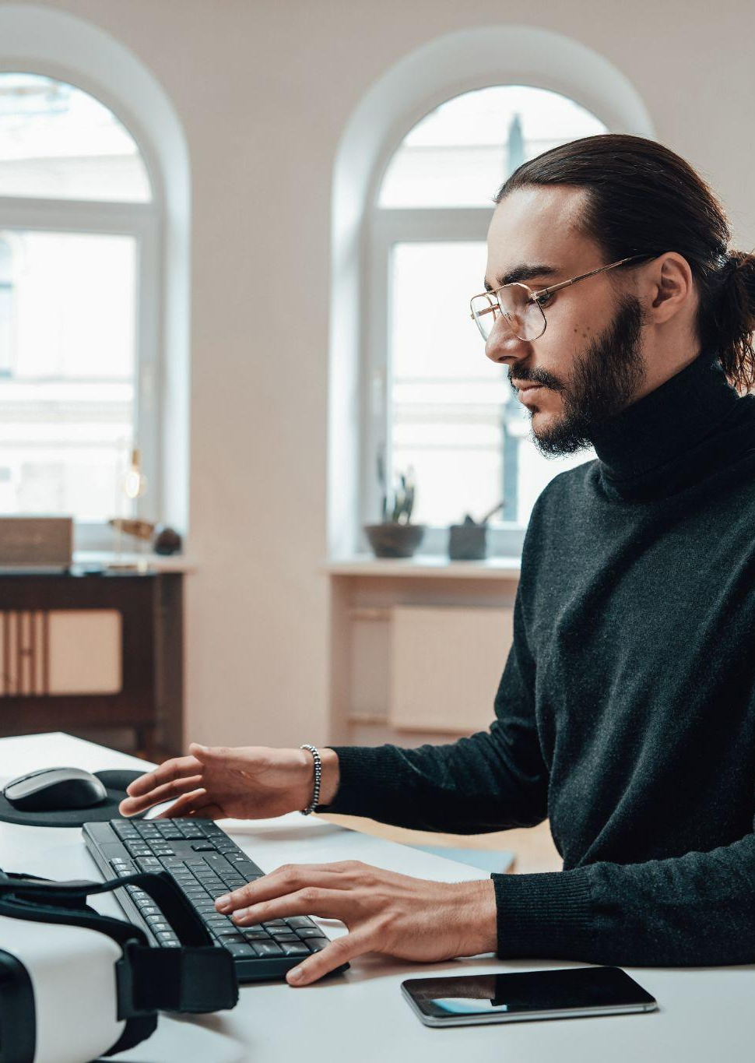
Choose the correct option. There are positive and negative personality traits. Be ready to report to the whole class.
John is always methodical and meticulous in his work. He pays great attention to every detail and ensures accuracy in all his tasks.
Positive trait:
hardworking
detail-oriented.
Negative trait:
lenient
slow

Slide 28

Choose the correct option. There are positive and negative personality traits. Be ready to report to the whole class.
Emma is highly reliable and dedicated to her work. She consistently puts in extra effort and goes above and beyond to meet deadlines. She knows all her coworkers very well, but sometimes it’s hard for her to be flexible under certain circumstances
Positive trait:
hardworking
analytical
Negative trait:
extrovert
strict

Slide 29

Choose the correct option. There are positive and negative personality traits. Be ready to report to the whole class.
Lucía prefers home office, she works better in silence and relaxed at home. During meetings, she doesn’t speak a lot, and prefers to follow instructions. The always considers different factors and possibilities before making a decision.
Positive trait:
detail-oriented
analytical
Negative trait:
introvert
lenient

Slide 30

Choose the correct option. There are positive and negative personality traits. Be ready to report to the whole class.
Jennifer, an intern at a marketing agency, often comes up with unique and innovative ideas for campaigns. However, she doesn’t pay a lot of attention to details, sometimes overlooking critical aspects and making avoidable mistakes.
Positive trait:
sociable
creative
Negative trait:
impulsive
careless

Slide 31

Choose the correct option. There are positive and negative personality traits. Be ready to report to the whole class.
Carlos, an experienced project manager, is known for his laid-back style and his preference for a flexible work environment. He likes that his team works with freedom. However, this sometimes brings problems because projects are delayed or out of focus.
Positive trait:
flexible
impulsive
Negative trait:
lenient
strict
https://elements.envato.com/es/young-woman-using-laptop-and-relaxing-on-sofa-M6RPNJC

Slide 32
BREAKOUT ROOMS ACTIVITY
Workers’ personality traits
Report your conclusions to the whole class using these prompts:
We think John is ___________ and _________
We think Emma is _______________________
______ Lucía _________________________
________Jennifer _____________________
________ Carlos ____________________
Estimated time: 5 minutes
Notes:
A Ss opens the mic to report one of the discussions, encouraging oral production. In stronger groups, this slide can be omitted. Key:
John is detail-oriented and slow
Emma is hardworking and strict
Lucía is analytical and introverted
Jennifer is creative and careless
Carlos is flexible and lenient.
True
False
True
False
False
True
True
True

Slide 33
Final discussion
Can we always speak about personality traits that are absolutely positive or negative? Does it depend on the context or the person?
Estimated time: 5 minutes

Slide 34
Break-time
We’ll be back in 10 minutes!

Slide 35
Communicative focus

Slide 36
Oral focus

Slide 37

Oral focus lab
We will carry out different class activities to understand and put into practice the theoretical concepts we have seen.
In what way?
First, we will make a collaborative brainstorming to revise together some theoretical concepts. Then, you will work individually, and give a final revision to your work. When you are done, you will present your work and receive feedback. Finally, we will work collaboratively, sharing progress and asking questions.
Estimated time: 80 minutes + 10-minute break

Slide 38
Step by step
1
2
3
Step 1
Step 2
Step 3
Revise collaboratively
and work individually
Estimated time: 20 minutes
Share work and
receive feedback.
Estimated time: 40 minutes
Share progress
and ask questions.
Estimated time: 20 minutes

Slide 39

Let’s get started!

Slide 40
Step 1
Collaborative revision and individual work
Estimated time: 20 minutes

Slide 41

STEP 1 - PART I
Collaborative revision
Description of the activity.
We’ll revise together the theoretical material we saw last class.
Useful structures & vocabulary to describe personality traits.
Estimated time: 10 minutes
Notes:
Usar para las subsiguientes slides de Actividades en clase.

Slide 42
Language focus

Slide 43
LANGUAGE FOCUS
Personality traits
extrovert
unpunctual
strict
lazy
detail-oriented
impulsive
hardworking
rude
punctual
introvert
polite
lenient
Analytical
productive
slow
careless

Slide 44
STEP 1 - PART II
Individual work
Description of the activity.
Use this time before the break to complete your work individually and get ready for your oral presentations.
Estimated time: 10 minutes
Notes:
Usar para las subsiguientes slides de Actividades en clase.

Slide 45
Step 2
Share your work and
receive feedback.
Estimated time: 40 minutes

Slide 46
Oral task
Describe your working style according to the personality traits dealt with in class. Include an example and decide whether the trait is positive or negative.
Notes:
This is the assignment to be used in the following class, which will have an oral focus all throughout. Tell students to do some research and be ready to describe the product/service to the rest of the group

Slide 47
COLLABORATIVE ACTIVITY
Commitments
Attendance
Have an active participation in class, avoid distractions.
Active listening
Listen and process what others express in the class.
Attitude to learning
Be ready to keep learning at every moment. Sharing is welcome, collaborative work prevails.
Respect
Listen to each other, we can all express what we think. Let everybody participate. .

Slide 48
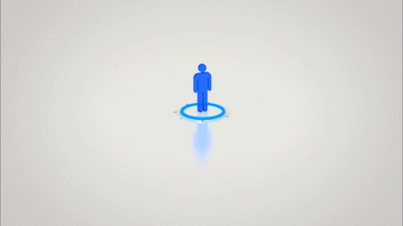
STEP 2 - PART II
Whole class
Sharing our work
Let’s share your work with the class!
Use this part of the class to share your work with the rest of the class and receive feedback from peers and teacher.
Estimated time: 25 minutes
Notes:
Usar para las subsiguientes slides de Actividades en clase.

Slide 49
Step 3
Share progress and
ask questions.
Estimated time: 25 minutes

Slide 50

STEP 3
Let’s clear your doubts!
Let’s do some revision
Firstly, think individually about any questions you may have. You can think about your own work or the work of others you have listened to.
Afterward, ask your questions orally or type them in the chat.
Estimated time: 25 minutes
Notes:
Usar para las subsiguientes slides de Actividades en clase.

Slide 51
Any questions?

Slide 52
See you next class!

